Slide 1
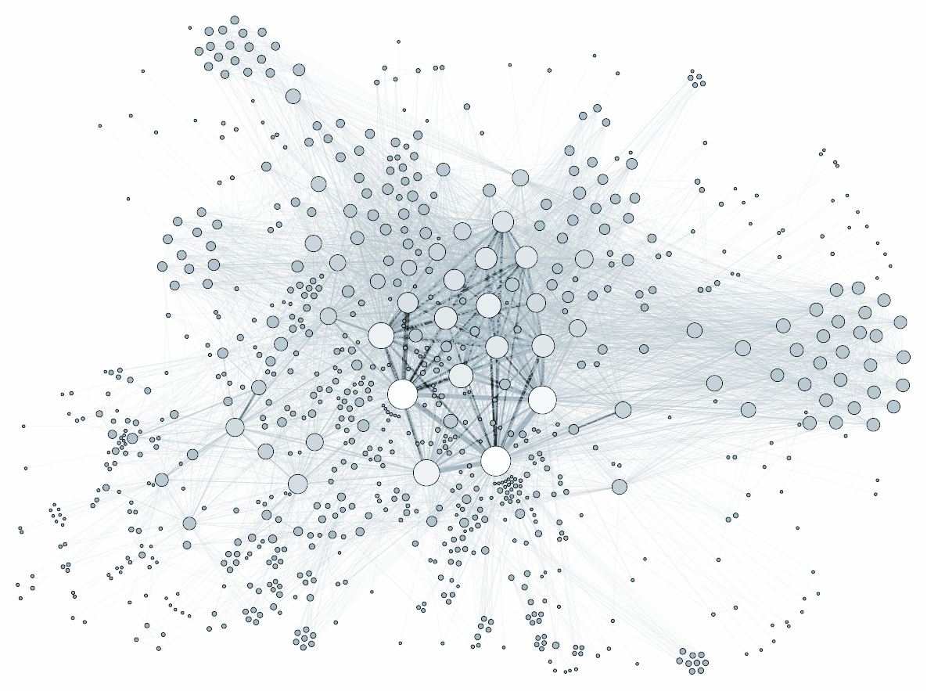
SOCIAL NETWORK ANALYSIS
PIB3 - Anh Thu DOAN

Slide 2
Introduction
The data is constituted of each member of the jury of Maître de Conferences (MCF) from 2017 to 2020.
To understand a community by mapping the relationships that connect them as a network and then drawing out key individuals, groups, or associations between the individuals.

Slide 3
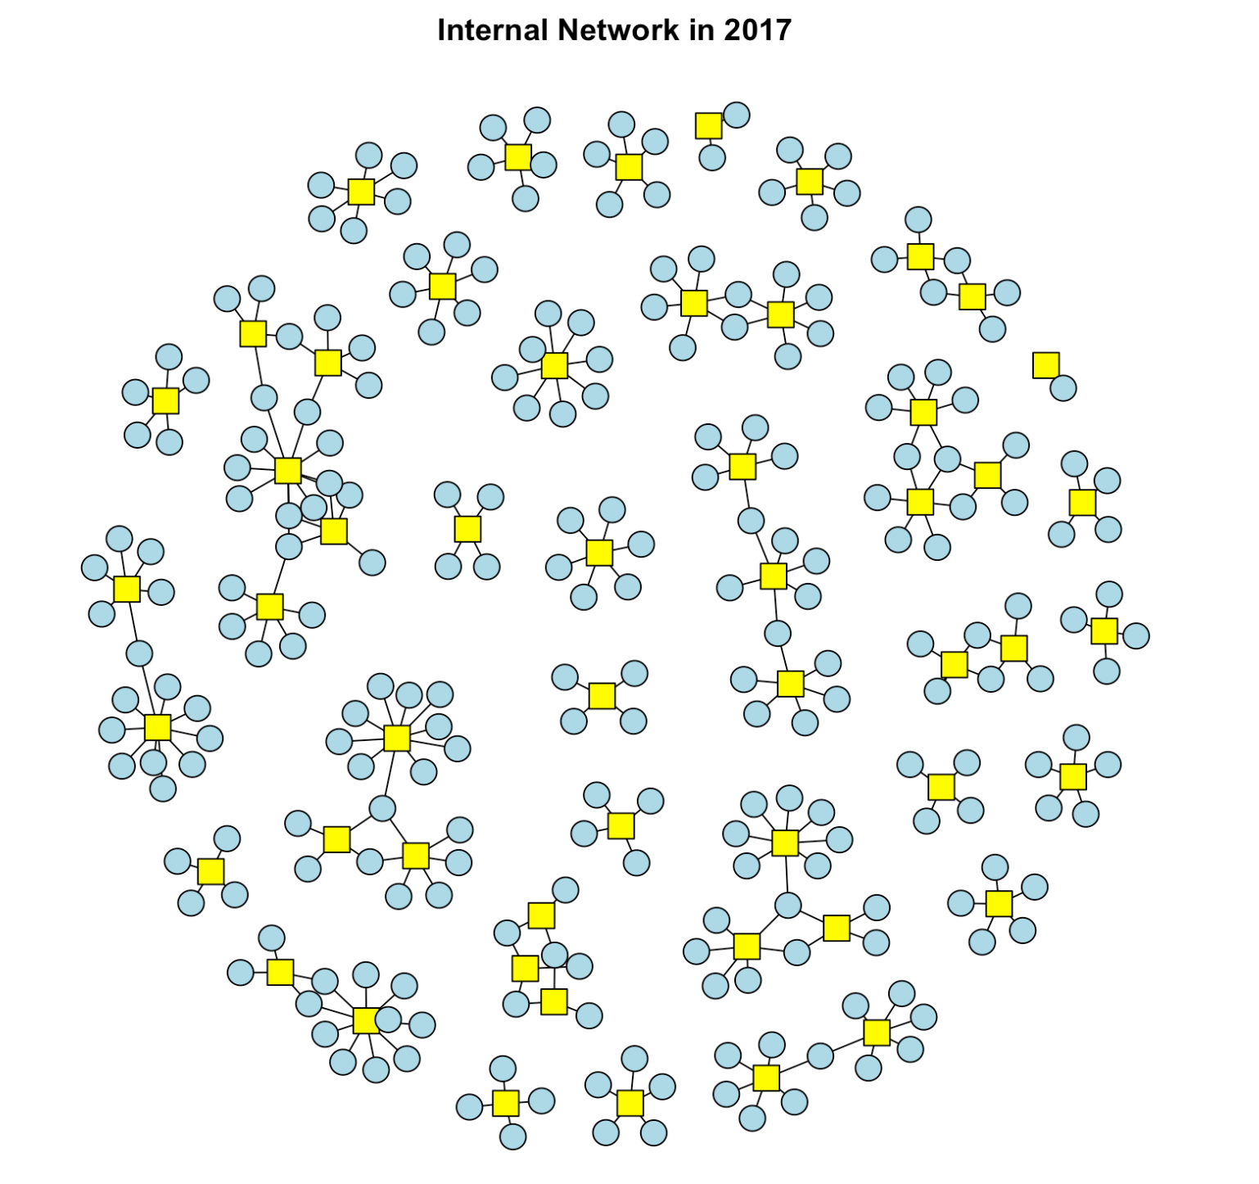
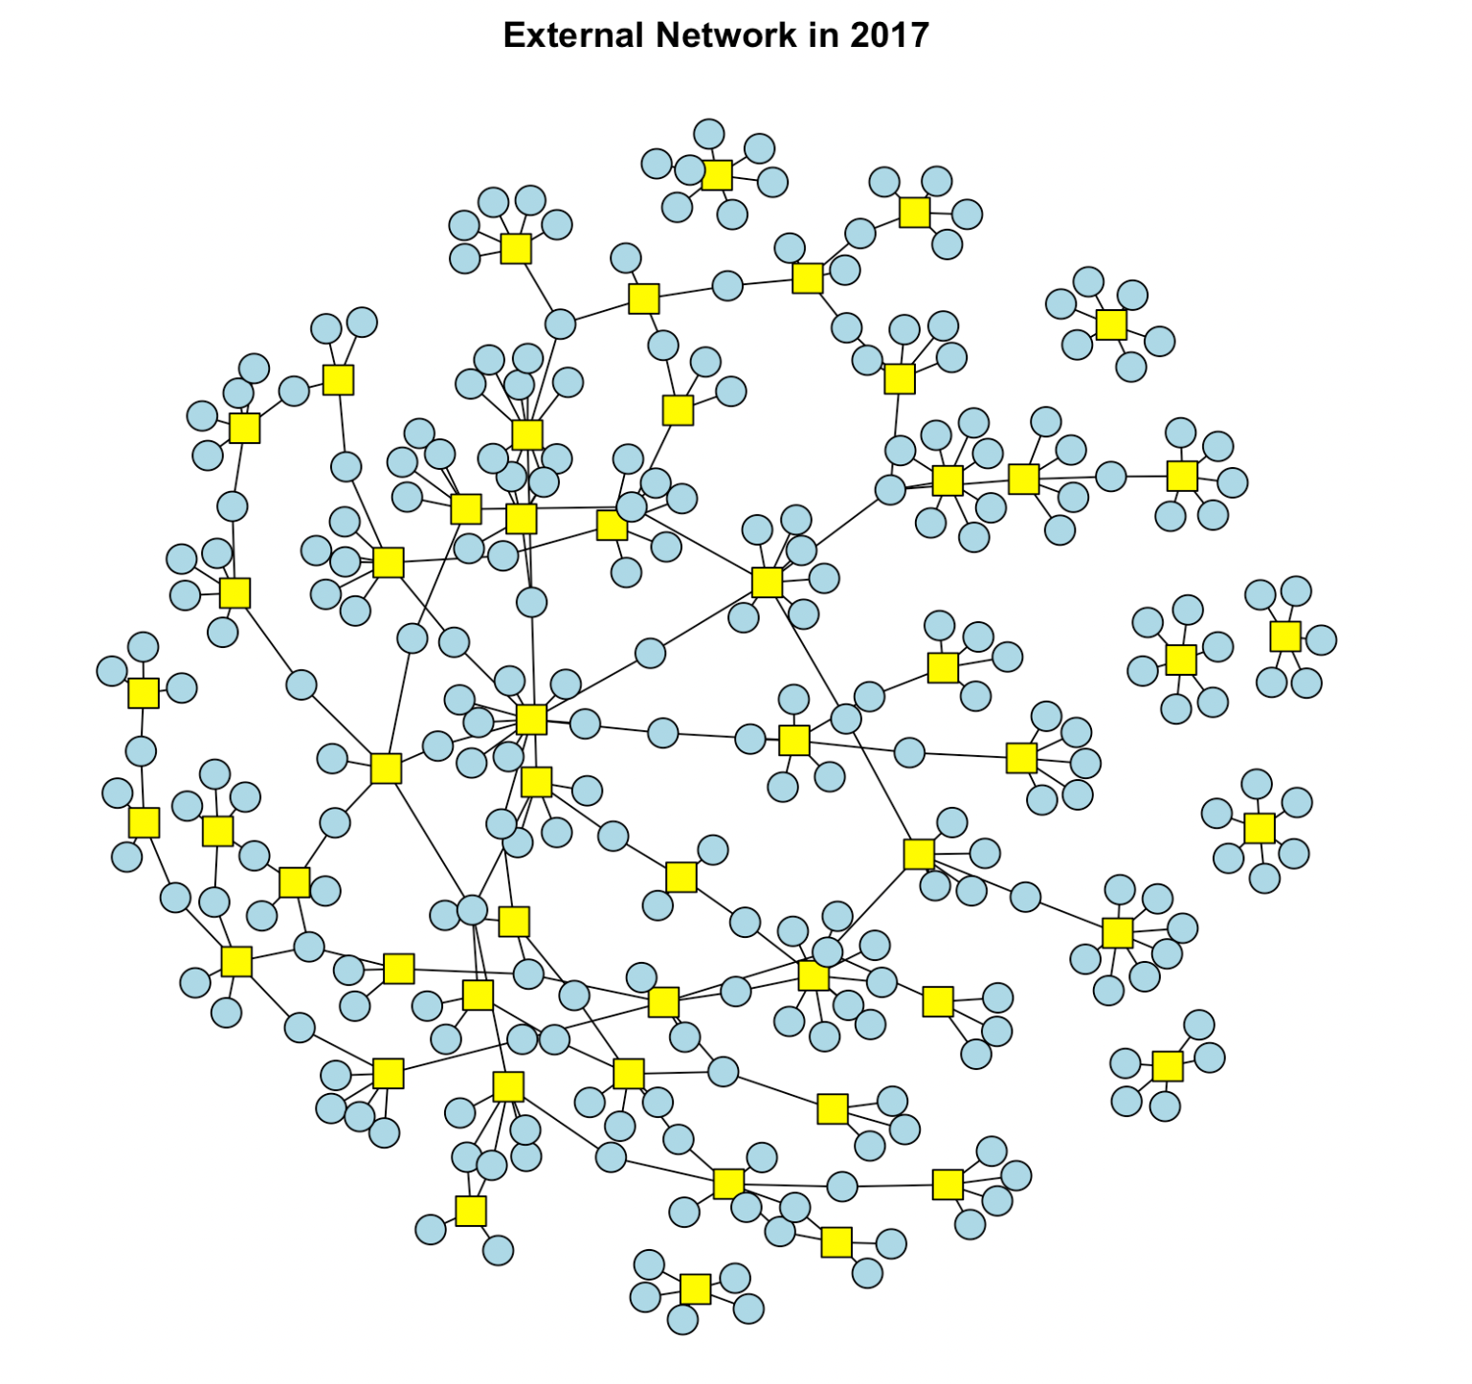
Simple SNA

Slide 4
Interpretation
Internal network was created by small cluster which only connected together with the same number of post.
In external network was also gather by small cluster but not only the same number of post connected together but also with the different number of post

Slide 5
Bipartite graph VS Multipartite graph
(k-partite graph is a graph whose vertices are or can be partitioned into k different independent sets)
Bipartite graph
When k = 2 these are the bipartite graphs
A graph whose vertices can be divided into two disjoint and independent sets
Multipartite graph
When k > 2 the graph can be called as the multipartite graphs
A graph whose vertices can be divided into more than two disjoint and independent sets

Slide 6
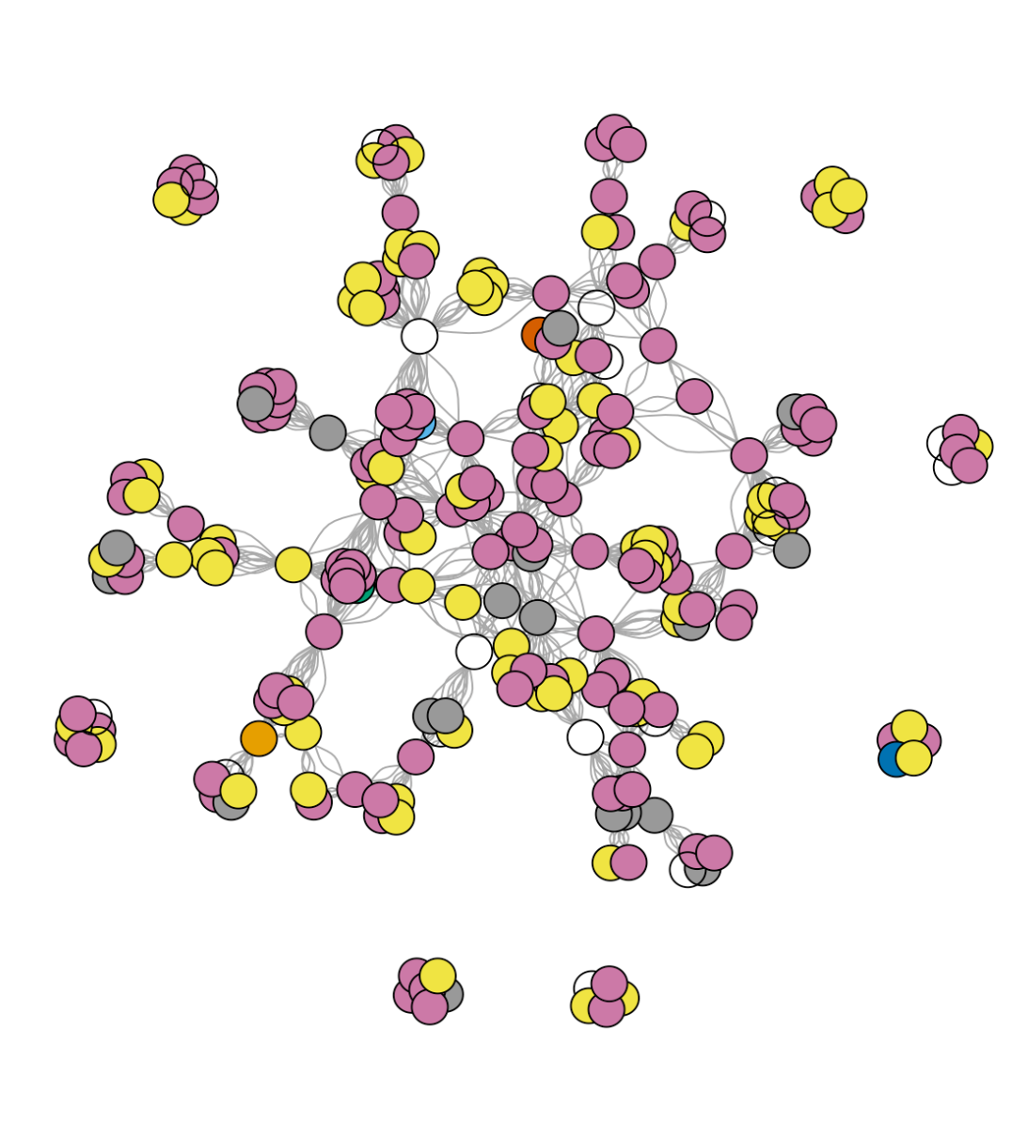
Edge list Vs Adjacency matrix
An edge list is a list (or array) of all the E edge in a graph. Each lists are one of the simplest representations of a graph
An adjacency matrix is a matrix that represents exactly which vertices/ nodes in a graph have edges between them.

Slide 7
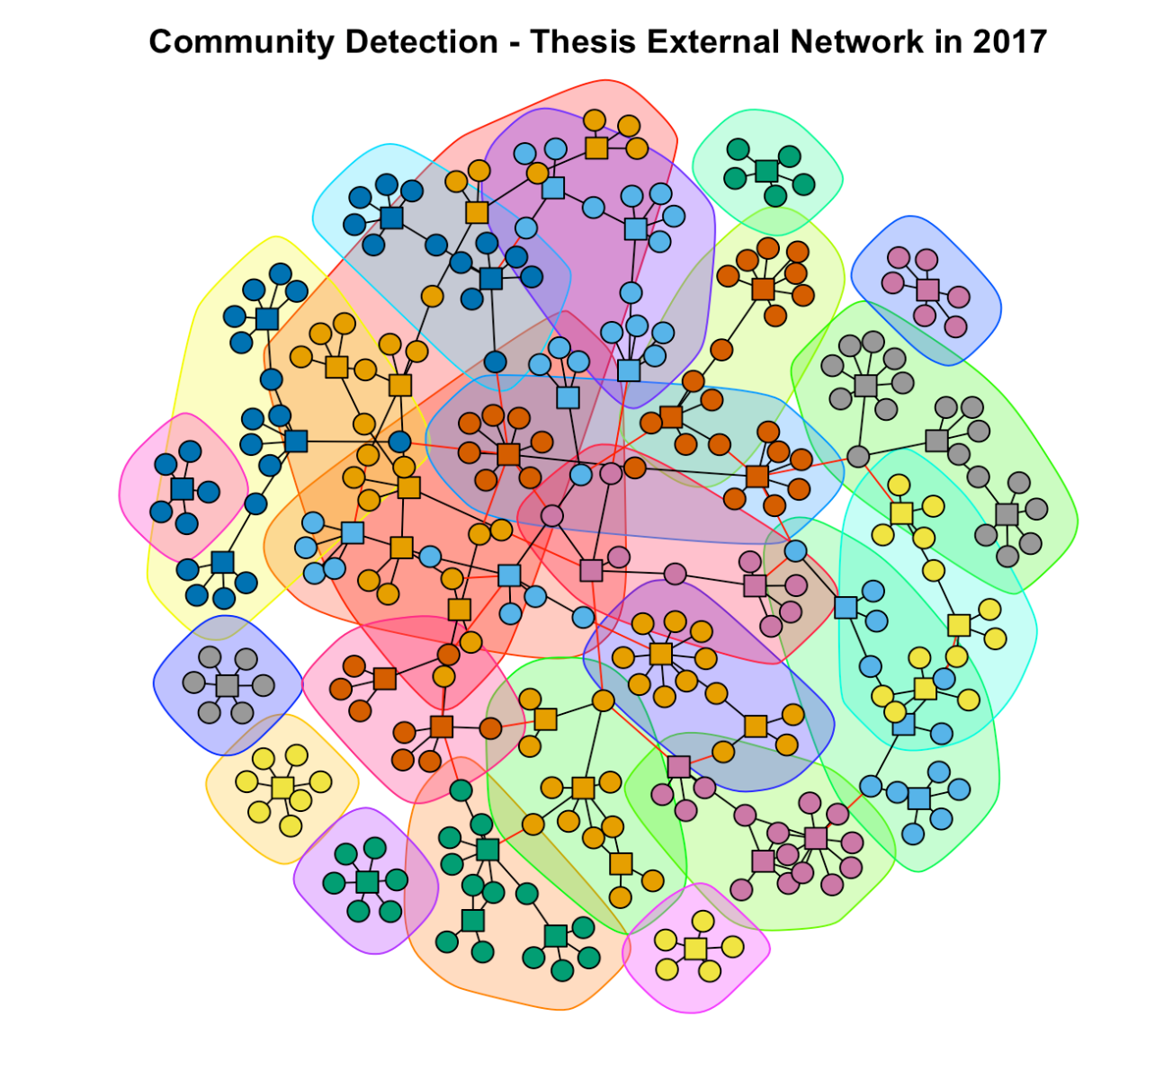
Community Detection
Every jury is not closed on itself
There is overlapping between the communities

Slide 8
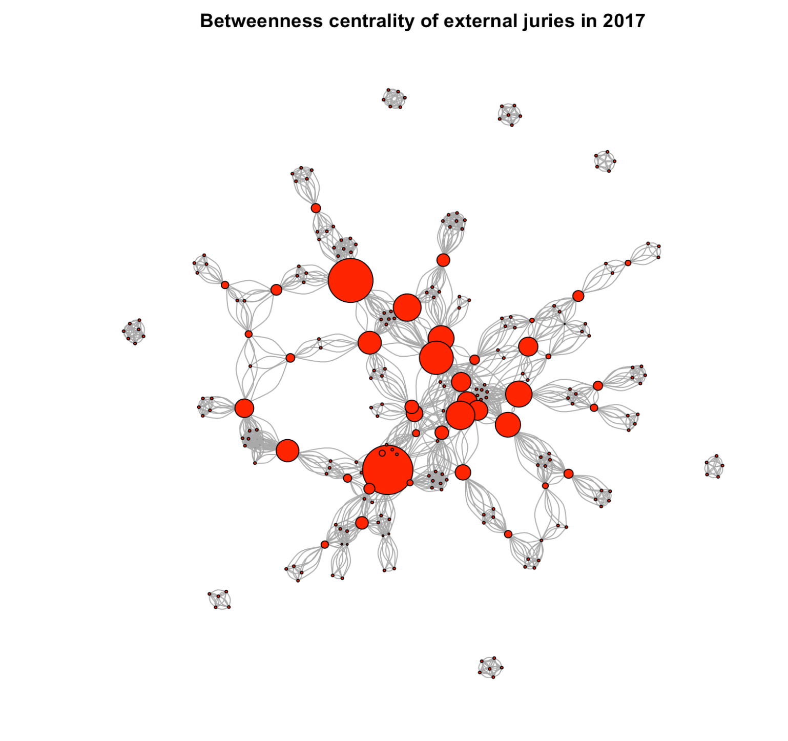
Betweenness centrality
The bigger the node higher the betweenness centrality.
This means, that on average the members of the juries with high node betweenness centrality have participated in many other smaller neighbour juries.

Slide 9
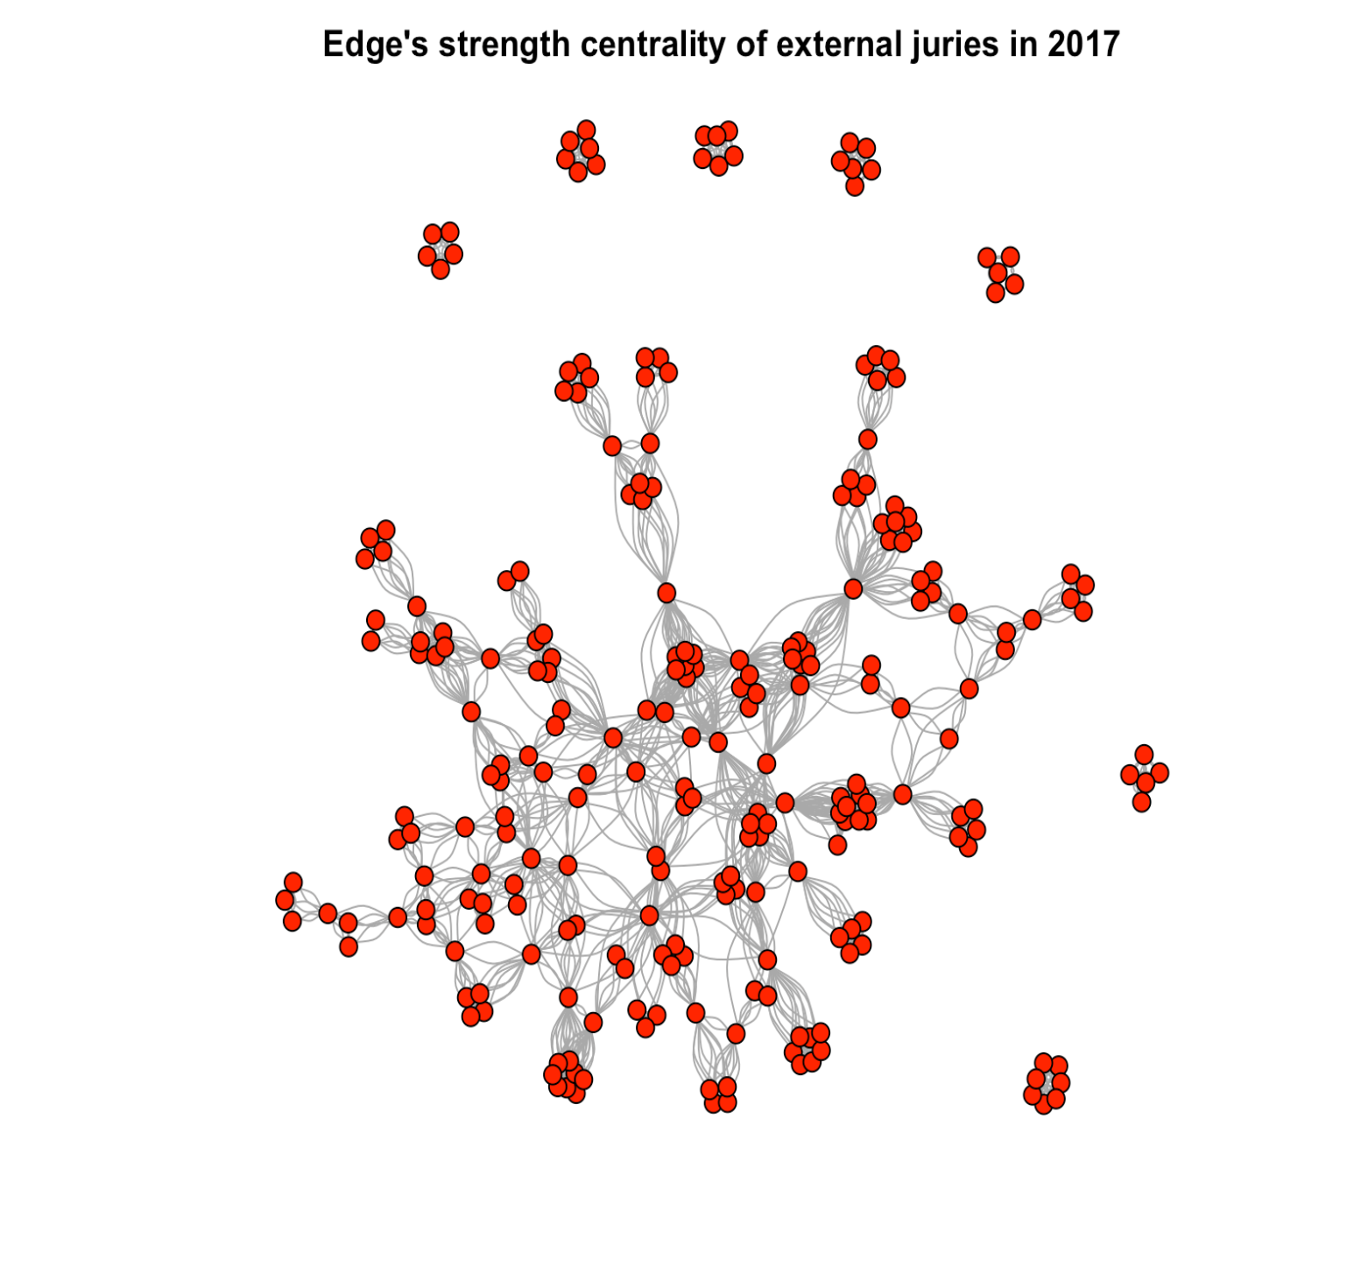
Edge Strength
Most of the nodes with high edge strength are centered in the middle of the social network as those juries corresponds to members of juries that participated in other juries represented by the neighbor nodes.

Slide 10
Sankey Diagram & Chord Plot
The dataset was used in this part is created based on the changing of number of student in Ygrec Bachelor Program
Methodology: Sankey diagram & Chord plot

Slide 11
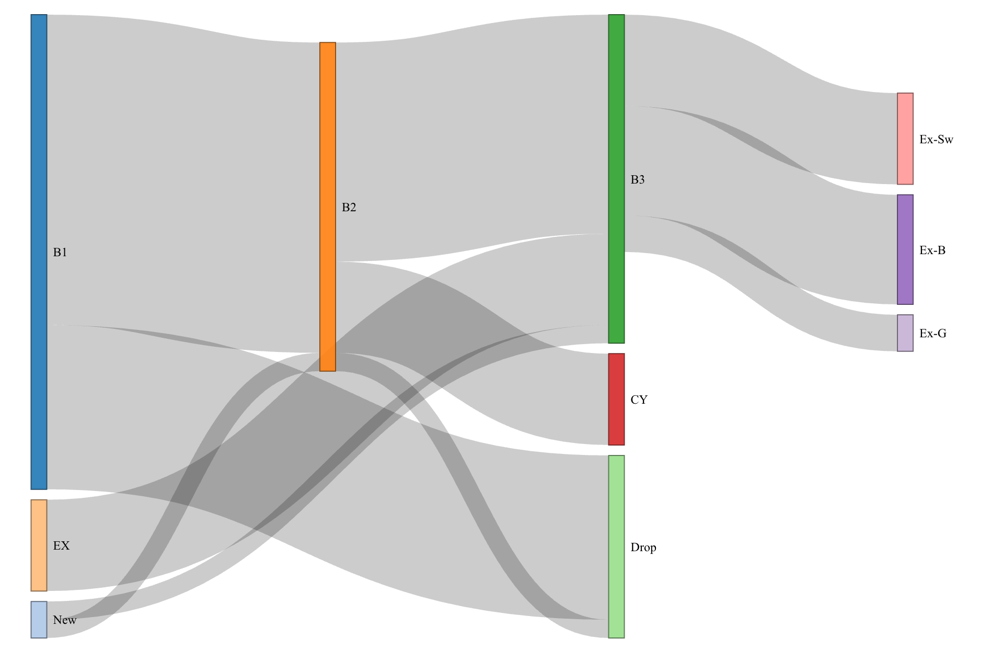
Sankey diagram
Around 35% of students dropped the program after the first year.
Also, 30% of the second-year students changed to the engineering program.

Slide 12
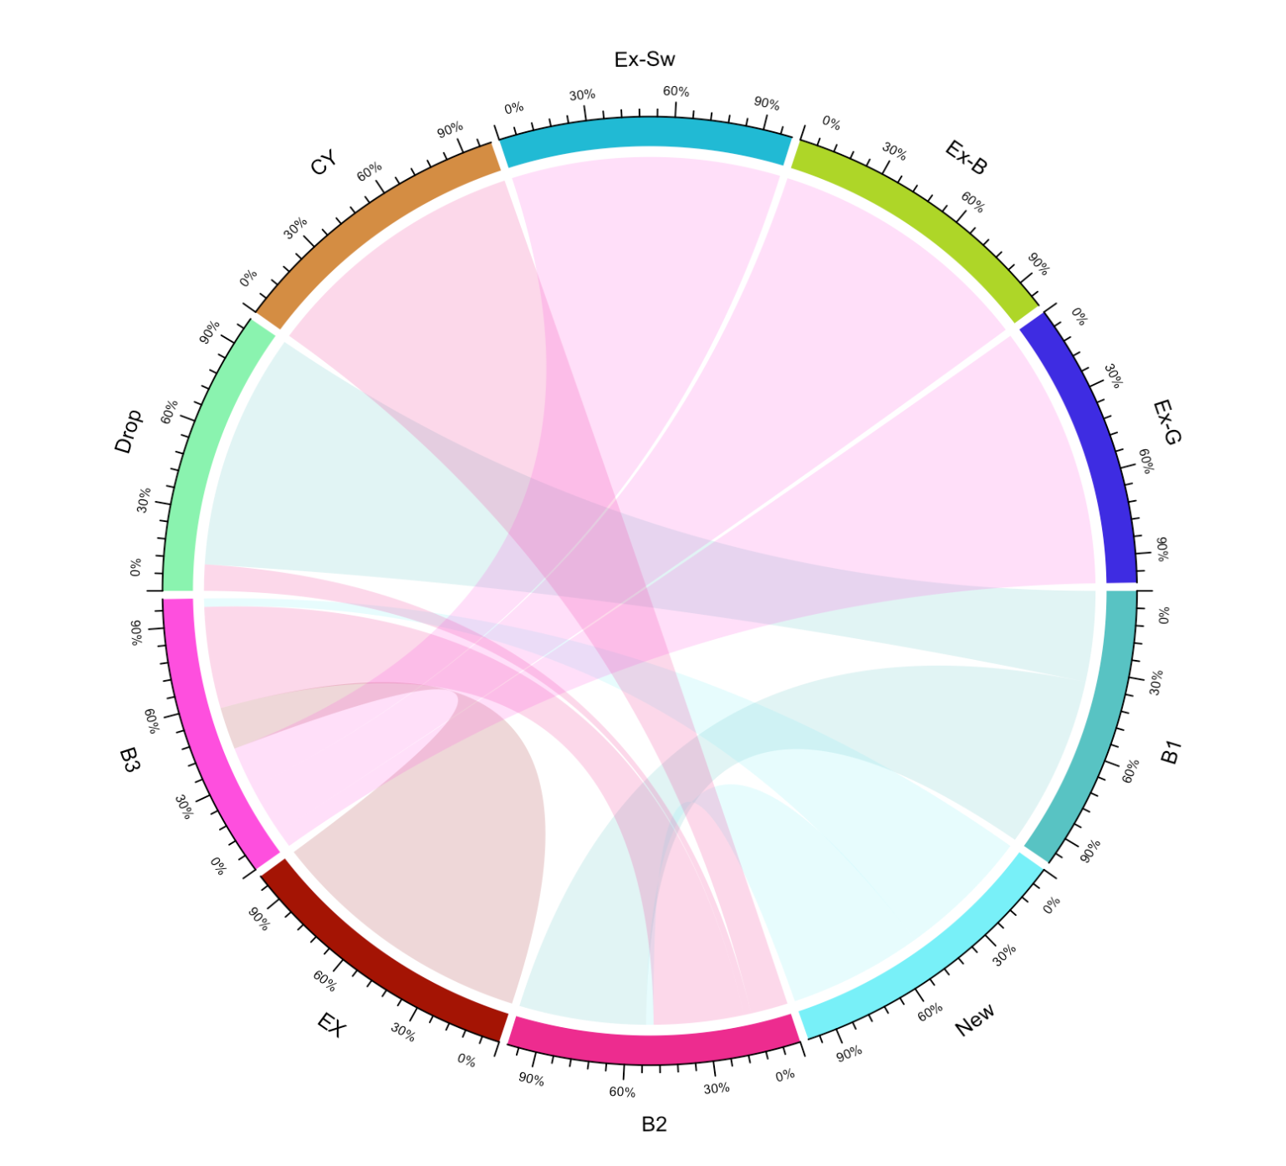
Chord Plot
How many percentages of students drop out of the program from B2 in the total dropped students?
20%
50%
10%

Slide 13
Association Rule Mining
There are 3 key metrics to consider when evaluating association rules:
Support
Confidence
Lift

Slide 14
LIFT
No direction ( lift{X,Y} is always equal to the lift{Y,X})
Lift{X,Y} = lift{Y,X} = support{X,Y} / (support{X} * support{Y})
If lift = 1; implies no relationship between X and Y (i.e., X and Y occur together only by chance)
If lift > 1; implies that there is a positive relationship between X and Y (i.e., X and Y occur together more often than random)
If lift < 1; implies that there is a negative relationship between X and Y (i.e., X and Y occur together less often than random)

